Slide 1
Practical Application of IFT
Dr. Vaibhav Kapare
Dept. Of Cardiovascular & Respiratory Physiotherapy
MGM Institute Of Physiotherapy
Chh. Sambhajinagar

Slide 2
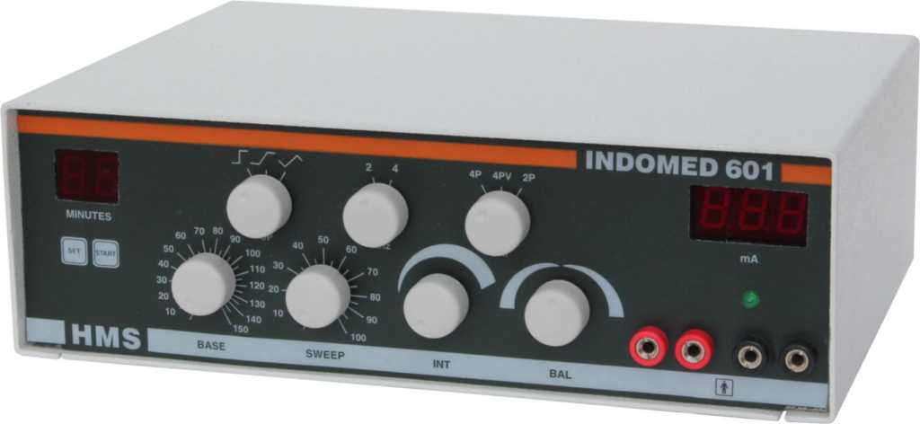
Panel Diagram

Slide 3
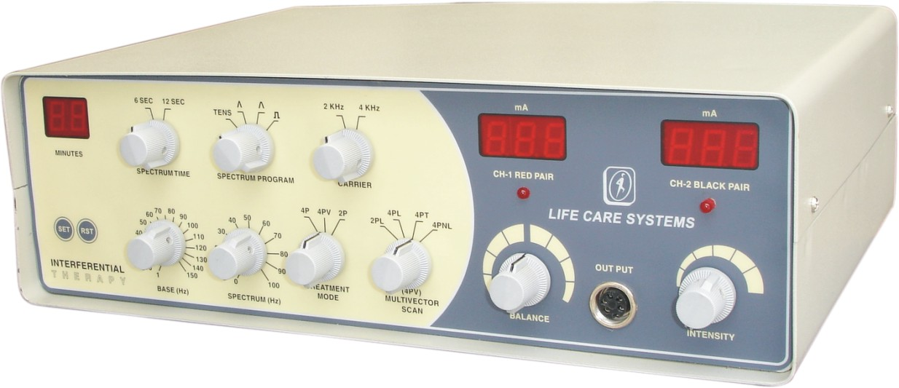

Slide 4
IFT i.e. Interferential therapy offers electrotherapy for pain. This therapy treatment uses electric current to stimulate tissue that helps in providing pain relief, reduction of swelling and other benefits.
It uses a range of frequencies that encourage the body to change positively such as increasing blood flow in a specific area which increases the speed of healing.
A lot of professionals in the medical industry use IFT due to its drug-free, non-invasive promotion of healing and pain relief.
IFT in physiotherapy has become extremely popular due to its ease of use and lack of any side effects.

Slide 5
Technique of application
Instrumentation
AMF parameter: To choose the basic value of the LF modulation/ Base that is desired.
Spectrum Parameter or Sweep: to set the range of variation in the AMF value that is desired; for ex. AMF at 100 Hz and spectrum at 50 Hz will give an AMF variation from 100 Hz up to 150Hz and back to 100 Hz.
Rotation Parameter: is applicable in case of vector currents only and sets the rate of rotation and the direction change of the AMF field within the tissues.
Intensity: use an intensity of current which produces a strong but comfortable prickling
Duration of Treatment: IFC must be applied for 10-15 minutes by session

Slide 6
Methods of applications
Static interference
Dynamic interference
Quadripolar Method
Bipolar Method
Choice of electrodes; Carbon rubber, Carbon rubber with Gel pad, Self adhesive, Lint with metal, Suction electrode etc

Slide 7
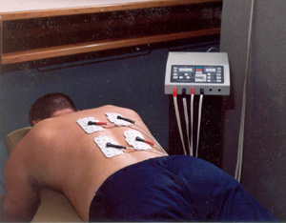

Slide 8
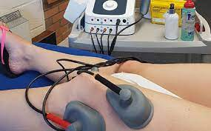

Slide 9
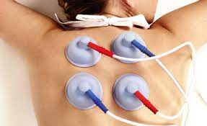

Slide 10
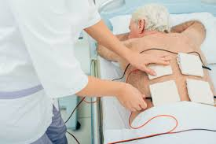

Slide 11
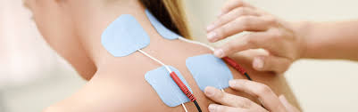

Slide 12
Principles of application
Check the apparatus in front of the patient.
Demonstrate the treatment to the patient.
Give an explanation of the treatment to the patient.
Explained about the type of sensation, which will be experienced by the patient.
Positioning the Patient: The position of the part to be treated should be completely relaxed. Patient should be made comfortable by using maximum number of pillows and sand bags for the support. Position of the patient should be such that all the joints of the body are completely relaxed. If possible give the position in which patient can see the treatment.

Slide 13
Skin sensitivity (testing) with hot and cold test tubes, U – pin, Vibrations.
Place electrodes properly. Use adhesive tapes or straps for placing the electrodes. Apply electrode gel evenly on entire electrode. Maintain good contact between the skin and the electrode. Strap the electrodes with even pressure.
Instruct the patient not to move, fall asleep, touch cables, wires or apparatus during the treatment.

Slide 14
Instruct the patient to inform the therapist about excessive current, overheating, burning sensation or not comfortable.
Increase the intensity knob till it is comfortable for the patient.
Duration of the treatment is decided on the basis of the condition.
The patient must be observed throughout to ensure that treatment is progressing satisfactorily and without adverse effects.

Slide 15
Termination of Treatment: Switch off the machine and the main supply. Remove the electrodes and clean the patient. Inspect the treated part for any adverse reactions. If there is any mild Erythema, apply powder or cold pack. If it is too severe, then advise him/her to go to the physician.
Record of all parameters of treatment including region treated, technique, dosage, and the resultant effect must be made.

Slide 16
Check List
Receiving the patient
History taking or going through the case sheet
Checking for general contraindications
Checking for local contraindications
Preparation of the tray
Preparation of the apparatus
Gaining the confidence of the patient
Positioning the patient
Preparation of the patient
Positioning of the electrodes
Application to the patient
Termination of the treatment
Record about patient’s condition
Home instruction

Slide 17
Case Scenario/Dosimetry
Apply four pole vector IFT to a patient with knee pain
Duration;…………………………
Base;……………..
Sweep/ Sectrum;…………….
Intensity range;…………

Slide 18
IFT as part of the treatment regime
The use of IFT should be considered as a part of the whole treatment regime. The treatment may include the following exercises:
  Stretching injured muscles
  Moving stiff joints
  Strengthening muscle groups to support the joints

Slide 19
Thanks

